Slide 1

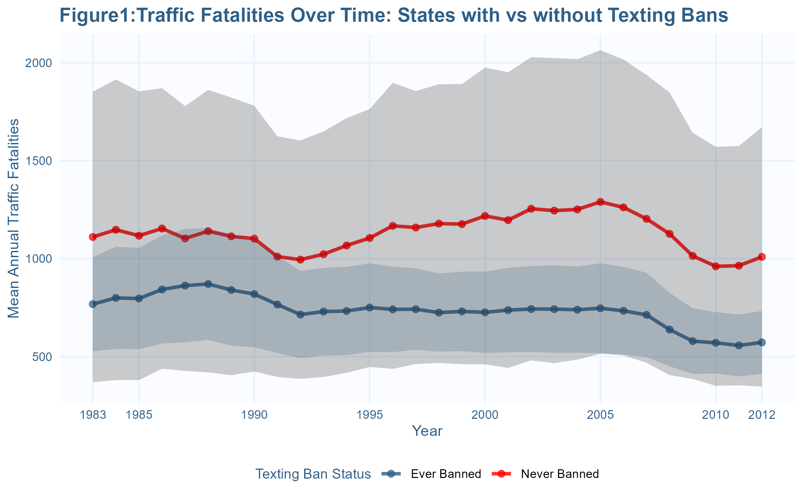
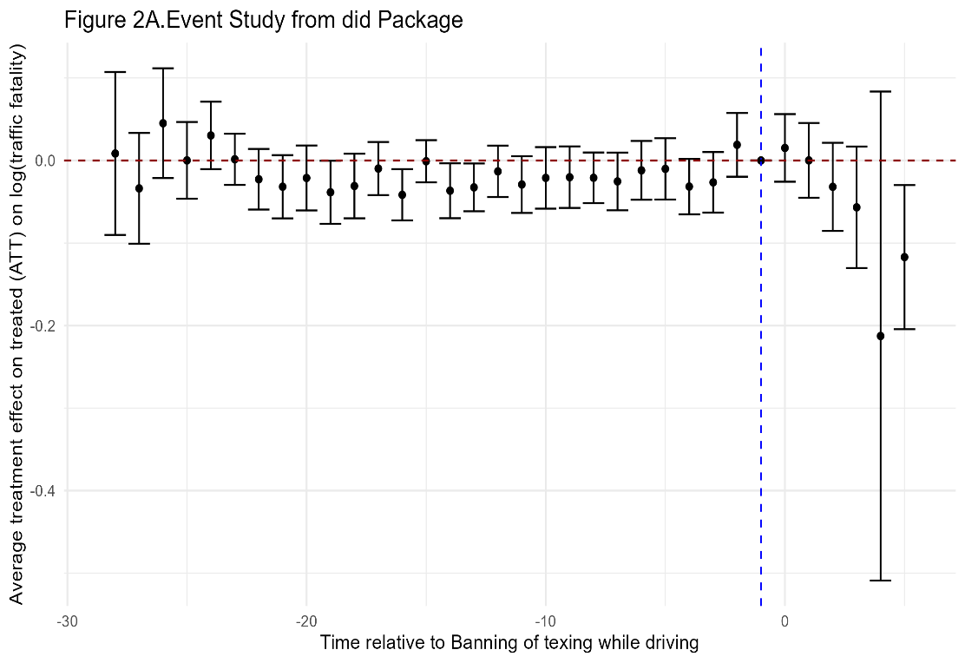
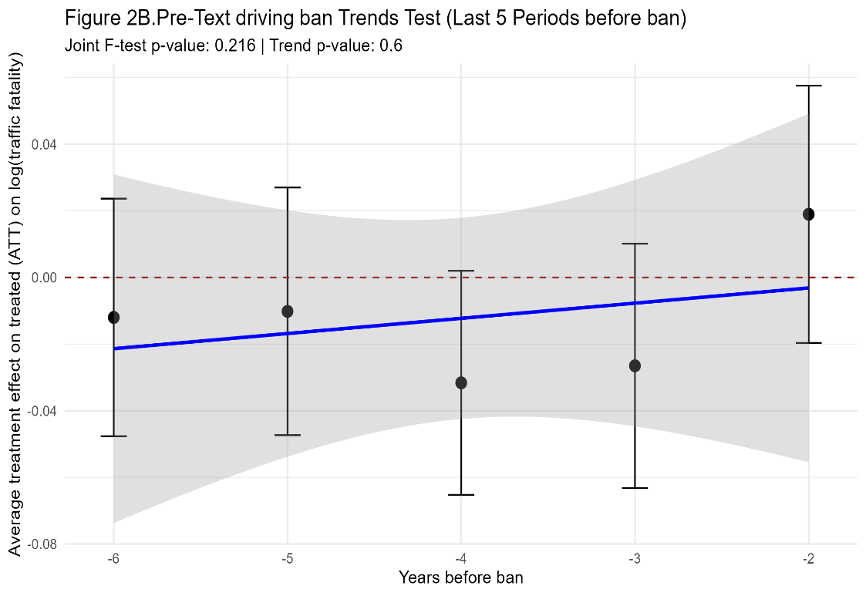
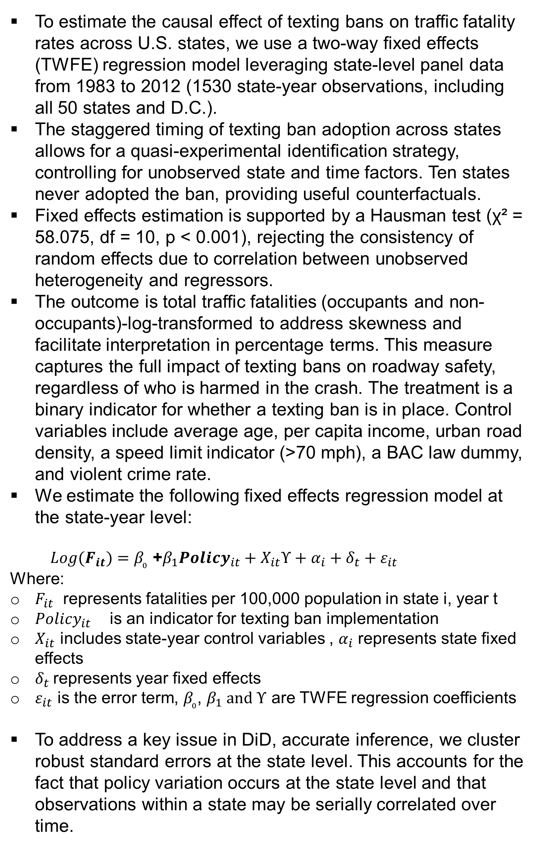
Do Anti-Texting Laws Work? Evidence from the US Traffic Fatality Data
Submitted in fulfilment of course requirements for Data Analysis and Statistical decision Making
Vincent Alulu¹
¹University of California, San Diego
ABSTRACT
BACKGROUND
RESULTS
DISCUSSION
Distracted driving kills over 3,200 Americans annually, with cellphones involved in 14% of fatal crashes. Young drivers are disproportionately affected, accounting for more than half of these incidents. Since 2007, 49 states and U.S. territories have adopted texting-while-driving bans, creating a natural experiment with staggered implementation and varying enforcement.
This study evaluates the effectiveness of these laws in reducing traffic fatalities using a two-way fixed effects (TWFE) regression model on panel data from all 50 U.S. states plus D.C., covering 1983–2012 (1,530 state-year observations). The identification strategy exploits variation in the timing of policy adoption while controlling for unobserved state-specific and time-varying factors. Fixed effects were preferred over random effects, supported by a Hausman test (χ² = 58.075, p < 0.001), indicating non-random policy adoption.
Our outcome is log-transformed traffic fatalities per 100,000 population. Controls include demographic characteristics, per capita income, road and alcohol laws, and crime rates. Results show a consistent 5.3–6.5% reduction in fatalities associated with texting bans across all model specifications. Event study analysis confirms the causal interpretation, with no evidence of pre-trends.
Speed limits above 70 mph are associated with 12–14% higher fatality rates, while BAC limits below 0.08 show no significant effect. These findings offer robust evidence that texting bans are effective, cost-efficient tools for improving traffic safety. Policymakers should strengthen enforcement and consider adopting or reinforcing bans in remaining jurisdictions.
Distracted driving kills 3,275 Americans annually (National Highway Traffic Safety Administration, 2024), with cellphones involved in 14% of fatal crashes, disproportionately affecting young drivers (15-30 years old), who account for over half of these incidents.
Wilson et al (2010) found that after declining from 1999 to 2005, fatalities from distracted driving increased by 28% after 2005, rising from 4572 fatalities to 5870 in 2008
Since 2007, all 49 states and U.S. territories banned texting while driving, creating a natural experiment. Enforcement varies, primary (direct stops) vs. secondary (requires another violation), providing key insights into policy effectiveness.
Research shows mixed impacts: bans reduce crashes with strict enforcement but may increase collisions if drivers hide phones. Effects often fade within 4 months, highlighting enforcement's key role. Effectiveness varies by age, texting bans help young drivers most, while adults benefit more from handheld restrictions.
Methodological challenges persist, from measuring actual texting behavior to isolating policy effects in the wake of policy change.
We employ two-way fixed effects DiD on state fatality data to estimate the impact of texting bans while accounting for real world policy adoption challenges.
Texting bans show a consistent negative association with traffic fatalities across all models. Model 0 indicates a 6.5% reduction in fatalities (p < 0.001), and this effect remains robust (-5.3% to -6.5%) even after adding controls. The results suggest these bans significantly improve road safety.
Demographic factors reveal unexpected patterns. Older populations correlate with higher fatality rates, possibly due to crash survivability differences. Per capita income has a minimal effect, indicating economic factors play a minor role compared to policy interventions.
Speed limits above 70 mph strongly increase fatalities (12–14% higher rates). Seatbelt laws show mixed significance, while blood alcohol concentration limits under 0.08 have no detectable effect. This highlights varying impacts of different safety policies.
Including violent crime rates as a control reveals a small but significant link to higher fatalities.
The texting ban effect persists even after accounting for this, reinforcing its independent impact. Models explain 90–92% of variance, supporting their reliability.
The findings strongly support texting bans as effective policy tools, reducing fatalities by 5–6%. The consistent results across models suggest a causal relationship, aligning with distracted driving research. This effect size is meaningful for public health, given traffic fatality rates.
The unexpected link between older populations and higher fatalities warrants further study. It may reflect differences in crash outcomes rather than crash frequency. Income’s negligible role suggests targeted policies matter more than broad economic factors.
Higher speed limits clearly increase fatalities, reinforcing the need for stricter enforcement. Seatbelt laws’ varying significance suggests interactions with other policies, while BAC laws’ lack of effect may stem from widespread existing adoption.
Violent crime’s association with fatalities hints at broader behavioral or enforcement factors. Yet, texting bans remain effective regardless, emphasizing their standalone value. Future research should explore how social context and policy combinations shape traffic safety.
ROBUSTNESS ANALYSIS
We conducted two key tests to validate our findings using Callaway & Sant'Anna (2021) DiD estimator (R "did" package):
(a) Event study of texting ban effects over time
(b) Pre-trends analysis (5 years pre-implementation)
Results confirm the policy effect is real, not driven by pre-existing differences, see results in Figure 2.
METHODS AND DATA
To estimate the causal effect of texting bans on traffic fatality rates across U.S. states, we use a two-way fixed effects (TWFE) regression model leveraging state-level panel data from 1983 to 2012 (1530 state-year observations, including all 50 states and D.C.).
The staggered timing of texting ban adoption across states allows for a quasi-experimental identification strategy, controlling for unobserved state and time factors. Ten states never adopted the ban, providing useful counterfactuals.
Fixed effects estimation is supported by a Hausman test (χ² = 58.075, df = 10, p < 0.001), rejecting the consistency of random effects due to correlation between unobserved heterogeneity and regressors.
The outcome is total traffic fatalities (occupants and non-occupants)-log-transformed to address skewness and facilitate interpretation in percentage terms. This measure captures the full impact of texting bans on roadway safety, regardless of who is harmed in the crash. The treatment is a binary indicator for whether a texting ban is in place. Control variables include average age, per capita income, urban road density, a speed limit indicator (>70 mph), a BAC law dummy, and violent crime rate.
We estimate the following fixed effects regression model at the state-year level:
$Log(F_{it})=β_{₀}$ +$β_{1}{Policy}_{it}+X_{it}ϒ+α_{i}+δ_{t}+ε_{it}$
Where:
$F_{it}$ represents fatalities per 100,000 population in state i, year t
${Policy}_{it}$ is an indicator for texting ban implementation
$X_{it}$ includes state-year control variables , $α_{i}$ represents state fixed effects
$δ_{t}$represents year fixed effects
$ε_{it}$ is the error term, $β_{₀}$, $β_{1} and ϒ$ are TWFE regression coefficients
To address a key issue in DiD, accurate inference, we cluster robust standard errors at the state level. This accounts for the fact that policy variation occurs at the state level and that observations within a state may be serially correlated over time.
Note: Shaded areas represent 95% confidence intervals. 'Ever Banned' includes both pre- and post-ban periods. States with texting bans (blue) had consistently lower traffic fatality rates than states without bans (red) from 1983–2012. Ban states averaged 650–750 annual fatalities versus 1,000–1,250 in non-ban states. Although fatalities declined in both groups after 2005, the safety advantage of ban states persisted, reinforcing the policy's effectiveness.
In pane 2A, the event study analysis reveals no pre-treatment effects (all coefficients ≈0), confirming parallel trends prior to texting ban policy implementation. Following texting ban adoption (t=0), we observe an immediate and sustained reduction in traffic fatalities, with effects strengthening over time. These robust results are supported by complementary pre-trends tests , see pane 2B, (F-test p=0.242) - demonstrating the causal effectiveness of texting bans in reducing traffic deaths
 | Dependent variable: Log(Traffic fatalities per 100,000 population)
Term | Model 0 | Model 1 | Model 2 | Model 3 | Model 4 | Model 5
Texting Ban | -0.065*** | -0.059*** | -0.063*** | -0.058*** | -0.053*** | -0.053*
 | (0.014) | (0.013) | (0.014) | (0.013) | (0.012) | (0.029)
Average Age |  | 0.034*** | 0.047*** | 0.046*** | 0.021*** | 0.021
 |  | (0.008) | (0.009) | (0.009) | (0.007) | (0.023)
Per Capita Income |  | -0.000 | 0.000*** | 0.000*** | 0.000*** | 0.000
 |  | (0.000) | (0.000) | (0.000) | (0.000) | (0.000)
Urban Density |  |  | -0.028 | -0.031 | -0.047 | -0.047
 |  |  | (0.038) | (0.038) | (0.034) | (0.061)
Primary Seatbelt Law |  |  |  | -0.025*** | 0.003 | 0.003
 |  |  |  | (0.008) | (0.011) | (0.023)
Blood alc conc< 0.08 Law |  |  |  | 0.012 | 0.011 | 0.011
 |  |  |  | (0.014) | (0.014) | (0.021)
70+ Speed Limit |  |  | 0.133*** | 0.132*** | 0.118*** | 0.118***
 |  |  | (0.017) | (0.017) | (0.016) | (0.031)
Violent Crime Rate |  |  |  |  | 0.000*** | 0.000***
 |  |  |  |  | (0.000) | (0.000)
Observations | 1530 | 1530 | 1530 | 1530 | 1530 | 1530
R² | 0.906 | 0.907 | 0.914 | 0.914 | 0.921 | 0.921
R² Adj. | 0.900 | 0.902 | 0.909 | 0.909 | 0.917 | 0.917
CONCLUSIONS
Table 1. Effect of Texting Bans on Traffic Fatality Rates.
Our analysis finds robust evidence that texting bans reduce traffic fatalities. Across multiple model specifications, the policy is associated with a consistent 5.3% - 6.5% decline in fatalities, even after controlling for state-level factors and time trends. Event study results show no pre-trends, reinforcing the causal interpretation.
These findings carry important policy implications. While texting bans alone won't eliminate distracted driving deaths, they offer a cost-effective way to save lives. In states where bans already exist, strengthening enforcement could enhance their impact. For the few remaining jurisdictions without such laws, adoption could still prevent avoidable fatalities.
CONTACT
REFERENCES
National Highway Traffic Safety Administration. (2024). Overview of motor vehicle crashes in 2023. U.S. Department of Transportation. https://www.nhtsa.gov. See statistics here: https://crashstats.nhtsa.dot.gov/Api/Public/ViewPublication/813703?utm_source=chatgpt.com
Wilson, F. A., & Stimpson, J. P. (2010). Trends in fatalities from distracted driving in the United States, 1999 to 2008. American journal of public health, 100(11), 2213-2219.
Vincent Alulu
GPS , UC San Diego
Email: valulu@ucsd.edu
Phone: 8582414795
Website: ________
Note: Standard errors in parentheses. All regressions include year and state fixed effects. The dependent variable is the natural logarithm of traffic fatalities per 100,000 population. Model 0 includes only the texting ban indicator. Model 1 adds demographic controls. Model 2 adds road infrastructure controls. Model 3 adds safety policy controls. Model 4 adds violent crime rate. Model 5 replicates Model 4 with state-clustered standard errors. Per capita income measured in thousands of dollars. Primary seatbelt law allows police to stop drivers solely for seatbelt violations. * p < 0.1, ** p < 0.05, *** p < 0.01.
Data source: supplied by the professor.

